Slide 1



NEXT STEPS IN AIRLINE RETAILING:
WHAT BREAKTHROUGH INNOVATION CAN ADD TO EXISTING POLICIES AND PROJECTS

Slide 2



RETAIL IS SELLING GOODS & SERVICES DIRECT TO END-USERS FOCUS ON RETAILING IS KEY IN OUR CUSTOMER INTIMACY AMBITION
Impersonal ticket sales to the masses with value added services
Retailing is core business
Notes:
Retailing is the activities involved in selling (or renting) consumer goods and services directly to ultimate consumers for their personal or household use.
Retailing does not include sales of consumer products to intermediaries.
A retailer is a firm that derives more than half of its sales revenues from sales made directly to ultimate consumers.

Slide 3

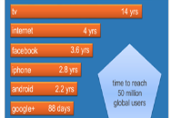


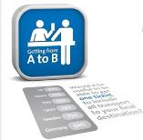
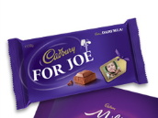

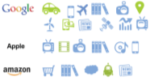
EXTERNAL DRIVERS STIMULATE AIRLINES TO MOVE TOWARDS INNOVATIVE RETAILING
Staff & customers “always connected” means products and services are sold everywhere and anytime
Increasingly rapid technology adoption by consumers shortens competitive advantages
The “explosive” growth of E-commerce has reduced the value-add of traditional retailing channels
Big Data predictions enable retailing of the right offer, at the right moment and place
Passengers increasingly expect to be able to buy Seamless Travel
Travelers demand Personalization & Choice
in the buying process
Commoditization of the airline industry; airlines need new revenue sources
Fast Digitization of the world changes business models and leads to cross-overs to/from retailing

Slide 4
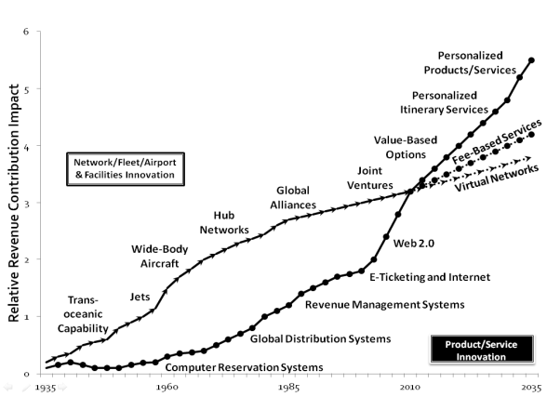
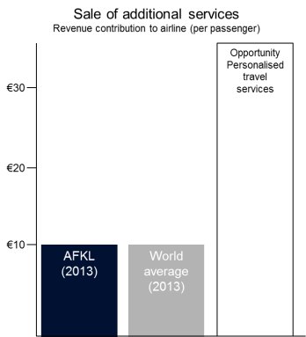
RETAILING OF PERSONALIZED PRODUCTS ALSO OFFERS BRAND DIFFERENTIATION & NEW REVENUE POTENTIAL TO AFKL
Source: Nawal Taneja, Designing Future-Oriented Airline Businesses , 2014
Source: Frost & Sullivan/Amadeus, AFKL (paid options, commission based revenue, FFP)
Notes:
The changes in operations and products are in the right direction, and they are necessary, but they are not sufficient to meet the ever increasing demand and expectations of empowered consumers and the needs of the airlines to enhance their margins consummate with their investments and risks relative to other businesses. The step that they need to take is to move further in the direction of customer centricity by capitalizing on the digital and mobile spaces.
This tension is not only beginning to be recognized but also being addressed by the more innovation minded airlines
AFKL 416 77,3
World average
Potential (Amadeus study, june 2014)

Slide 5
WHY ARE AIRLINES TRADITIONALLY NOT GOOD RETAILERS?
Travel Agents are the retailers
Built around infrastructure and operations
Own airline operational complexity
Legacy airline industry technology
Business & functional silos

Slide 6
BEST-IN-CLASS RETAILERS PERSONALIZE TO BE RELEVANT, DIFFERENTIATE AND ARE EASY TO DO BUSINESS WITH
Users’ experience
Tracking behavioral data and data from third parties in order to offer relevant content based on individual tastes
Seamless connectivity
Leverages mobile technology to make the process of ordering and using a taxi service much more customer centric and personalized
Innovation and creativity
Interactivity and engagement are key features of their use of technology. It allows them to reduce queues and provide personalized experience
More responsive
They are taking the use of big data and analytics one step further by deploying an “anticipatory shipping” process
Notes:
Netflix has built a loyal base of fans through personalization. The US online provider of on-demand media offers relevant content based on individual tastes. It gives people what they want and when they want, providing timely recommendations on movies and TV shows. Netflix management is very focused on customer centricity, particularly users’ experience. The company tracks behavioural data —who is watching, which programme, when, on which device and length of time, including early closure on selected titles, and return to selected titles. Netflix also reportedly obtains data from third parties such as Nielsen and integrates data from social media.
Uber Moving People, a concept developed by transportation company Uber, leverages mobile technology to make the process of ordering and using a taxi service much more customer centric and personalised. Mobile is the central nervous system that connects a customer’s location identified through GPS to the driver, providing an exact pick up location. The customer in turn can use the mobile device to track the driver’s whereabouts, as well as identify the driver’s name and vehicle type. Fares can be quoted in advance by providing the pick-up and drop-off locations and the cost can be charged to a credit card already on file with the company. This is clearly a business that has been designed to provide seamless connectivity using mobile technology.
Disney has focused on innovation and creativity to improve the guest experience; by taking a holistic view of the customer, Disney provides a seamless and stress-free experience at all touch points, whether it be vacation planning, purchasing, visiting theme parks, and sharing memories afterwards with family and friends. Disney is using technology to enable its guests to make the most of their limited time, so that they can enjoy the rides and shows instead of waiting in lines; at the same time they are trying to encourage guests to spend more money onsite in stores and restaurants. Interactivity and engagement are key features of Disney’s use of technology. Interactivity allows Disney to (1) manage lines in which guests are kept engaged in an attraction’s story before they even get to the ride, which also makes the waiting time pass quickly (2) enable guests to have a personalized experience with selected characters.
Amazon has been making relevant recommendations for some time. Taking the use of big data and analytics one step further, Amazon can deploy an “anticipatory shipping” process that involves preparing and shipping a package before a customer even makes a purchase. Amazon would presumably be making such decisions based on a customer’s past searches, purchases and returns. Amazon may even be able to monitor the length of time that a potential customer has spent looking at a product online. This is important given that any delay between ordering and receiving may cause shoppers to go to a store instead of buying online.

Slide 7



WE HAVE MANY RETAILING CAPABILITIES, BUT WE REQUIRE A TRANSFORMATION TO BECOME A SUCCESSFUL RETAILER
CURRENT CAPABILITIES
CAPABILITIES TO DEVELOP
Data about our customers
Customer centric organization
(Physical) touch points with our customers
Optimized retail offering to customers
Strong loyalty program
Hardcore retailing skills
Social media skills and high number of active users
Big Data capabilities
Strong pricing & inventory skills
More mobile capabilities
Strong electronic and physical distribution capabilities
Appropriate organization
Strong brands
Notes:
If Big Data, analytics and mobile are to play a key role in an airline to redesign its business to do more with less and become a data-driven marketing powerhouse, then the airline must transform the IT function from a data collection and report production center to one that facilitates collaboration, communication and integration within all areas of the airline. Such a transformation requires a different mindset, a different set of skills and appropriate data-architectures. The challenge in organizational structure and culture is greater than the technology step
binnen de travel branche is directe verkoop aan de consument eerder ingezet dan in de retail en finance sectoren. De travel branche heeft daarom een voorsprong met betrekking tot het creeren van een unieke merkervaring en direct contact met de klant. Succesvolle merken specializeren zich steeds meer in het verbinden met de klant.

Slide 8



AIRLINE RETAILING MATURITY LEVELS CURRENT STATUS WITHIN AIR FRANCE KLM
level 1
+ level 2
+ level 3
The ancillaries assortment is currently essentially on par with competition and being expanded
Selling being expanded to other Air France and KLM touchpoints
Medium term ambition:
O&D pricing of options
Other carrier products v.v.
Travel related retailing
A la carte
All-in tickets
3rd party commission based options:
Taxi Hotel Event tickets
Duty free:
Wellness, media Luggage
Accessories
Fashion, toys
Watches Cosmetics Electronics Liquor & wine Watches Accessories
Baggage fees
Value-added options:
Seat selection
More legroom
Paid meal
Paid upgrades
Lounge access
Block empty seat
Time-to-Think
Flexibility
Missed flight insurance
Wifi onboard
UM’s
…
Source:GEC Ancillary Action plan FEB 2014
Notes:
AFKL have embraced the merchandising concept, as demonstrated through product unbundling and the marketing of ancillary products and services, in turn benefiting passengers and airlines alike. AFKL have also made significant progress in the areas of product enhancement and pricing in terms of “seat managing the values”.
However, they are still struggling in the area of “romancing” the customer, where an airline becomes the customer’s preferred choice, rather than the customer feeling forced to choose that airline.
how to build on this to get more revenues
As the portfolio of products and services increases, the need for content filtering and recommendations will grow
This requires investment in capturing knowledge about customers
Assuming this will be successful, from retailing?

Slide 9







RETAILING MATURITY LEVELS WHAT COULD BE NEXT IN RETAILING FOR AIR FRANCE-KLM
New business models
level 1
+ level 2
+ level 3
+ level 4
+ level 5
+ level 6
Smart travel Assistant
Trip initiator
Core product:
trip
Core product:
trip
Personalized offers
+ level 7
Travel related retailing
A la carte
All-in tickets
General retailer
Core product:
seat
Core product:
seat
Core product: seat
Core product: personalized offer
Core product:
general retailing
Mass product
(product centric)
Personal solutions (customer centric)
Notes:
AFKL have embraced the merchandising concept, as demonstrated
through product unbundling and the marketing of ancillary products and
services, in turn benefiting passengers and airlines alike. AFKL have also
made significant progress in the areas of product enhancement and pricing
in terms of “seat managing the values”.
However, they are still struggling in the area of “romancing” the customer, where an airline becomes the customer’s preferred choice, rather than the customer feeling forced to choose that airline.

Slide 10

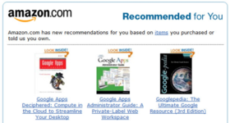
RETAILING MATURITY LEVELS LEVEL 4: PERSONALIZED OFFERS USING BIG DATA TECHNOLOGY
Selling process
Customer benefits
Capabilities needed
More relevant & simple choices to the customer
AFKL benefits
Increased conversion & repeat purchase
Greater insight into customer preferences, facilitating future marketing and merchandising efforts
Integration of data
Big Data analytics
Dynamic pricing
Retailing
Unified retailing approach towards customers
Offers based on travel behavior of different groups of customers with the aim of providing solutions
Personalized fares
Personalized packs
Optimize price based on customer lifetime value
Assortment
Competitors
Example
Same as level 3
Airlines
Notes:
“Deploying Big data with analytics, a few global innovation led legacy airlines could redesign their businesses and transition from being providers of air transportation services from airport to airport to selling travel experiences, or becoming total travel facilitators by connecting the dots and by working with new third party players. And, it is through the integration of data (connecting the dots) that will generate new value.” NT Designing Future Oriented Airline Business

Slide 11
RETAILING MATURITY LEVELS LEVEL 5: SMART TRAVEL ASSISTANT
Selling process
Customer benefits
Capabilities needed
Organize the entire journey by a digital journey manager, including all tickets, personal details and travel information with instant recognition on all touch points
Seamless travel
Real time: which means in case of disruptions Air France-KLM takes care of all the rebookings
‘On-the-go’ (mobile)
AFKL benefits
Differentiated higher margin product that reinforces the airline core
Increased power in the value chain by owning the customer relationship (switching cost)
More insight in customer behavior allowing future cross sell
Data standards & integrating the technology
Bringing together a variety of stakeholders, like travelers, mobility providers and service providers
Constructing the revenue model
Assortment
Competitors
Examples
Flights, public transport, taxi’s, rental/ car sharing, accommodation, events/experiences, restaurants/points of interests
Google Now
Future OTA’s, like Expedia
Future Airbnb
Other airlines moving to that level
New startups
Leaders in travel and tech have begun taking position
See slides 12-15
Notes:
“Deploying Big data with analytics, a few global innovation led legacy airlines could redesign their businesses and transition from being providers of air transportation services from airport to airport to selling travel experiences, or becoming total travel facilitators by connecting the dots and by working with new third party players. And, it is through the integration of data (connecting the dots) that will generate new value.” NT Designing Future Oriented Airline Business
Focusing on the job-to-be-done for the customers, means that providing a few elements of the journey is no longer enough. Customers require mobile door-to-door travel that integrates planning, booking and ticketing across all means of travel and transportation. It can reduce delays and make travel involving multiple stops and different modes of transportation easier, faster and more cost-efficient.
Key features of the Smart Travel Assistant include personalization based on the user’s needs and preferences, such as desired modes of transport. The Travel Assistant also learns from user behaviour, and provides guidance in (re)planning based on preferences and situations using input from real-time weather and traffic updates. The service would have global reach and tap into traditional modes of transportation, such as bus, plane and train service, and emerging modes such as urban bike-rental programmes and car-sharing services.
Assortment: end2end travel (incl events at destination)
Benefit: moves into the space currently occupied by GDS’s and travel agents.
Partners required might be large technology companies or a consortium of
smaller firms specialized in, for example, current global distribution systems.
Revenues through booking payments and advertising income
Successfully implementing the Smart travel Assistant depends not only on
integrating the technology and necessary data that are largely available, but also on bringing together a variety of stakeholders; travellers, mobility and service providers (ao airlines), public authorities and other private enterprises supplying real-time data.
Key is data standards, the revenue model
two major concerns involve privacy – the transfer of personal data across borders, and the mining of personal data to make proactive travel suggestions. Moreover, valid concerns exist with creating a monopoly. Separating IPITA operators into back-end and front-end providers would mitigate these risks. Another matter is the current lack of digitization and standards.
Managing complex journeys is in fact already something AFKL is already doing, eg in disruption management. As a network carrier is particularly vulnerable for disruptions, excelling in this area would be a great asset for the brands. Unfortunately, today this still involves a lot of manual involvement and the worst rated experience by customers.
two major concerns involve privacy – the transfer of personal data across borders, and the mining of personal data to make proactive travel suggestions. Moreover, valid concerns exist with creating a monopoly. Separating IPITA operators into back-end and front-end providers would mitigate these risks. Another matter is the current lack of digitization and standards.

Slide 12
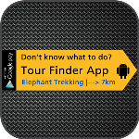
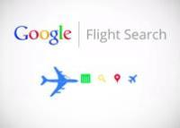
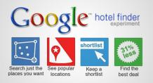
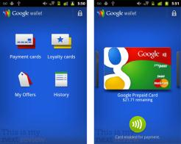

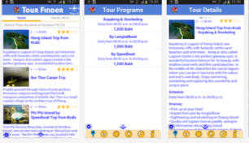
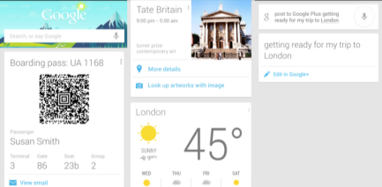
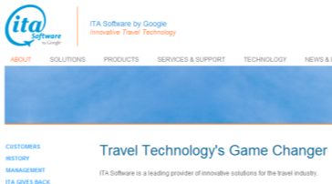
GOOGLE WANTS TO BECOME THE ULTIMATE TRAVEL AGGREGATOR AND ONE-STOP-SHOP
Example level 5
Notes:
And it is the information-rich and technology-savvy companies that will serve them by knowing them better (who they are, where they are, where they are heading, what their preferences are, and what challenges they are facing at the time)
From the opportunity perspective, airlines coud serve travelers better not only by knowing them better, but also by offering them everything from everyone that is necessary from the start to finish of their journeys.
Internet ‘pure play’ businesses (such as Amazon, eBay, Facebook and Goolge) are not likely to fly airplanes, but they do have the power to disrupt airline profits by leveraging the behavioral data available for the creation of direct and customized itineraries and offers that are timely, relevant and significant; e.g. through the “uberization” of the airline business

Slide 13
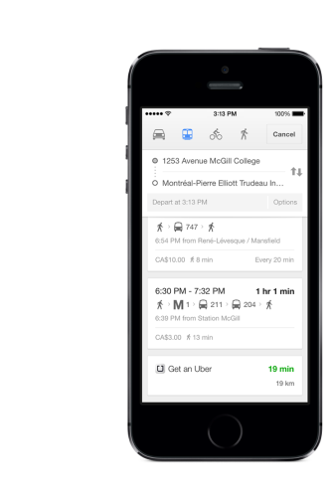
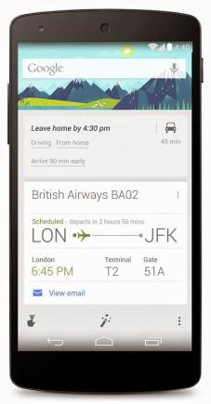
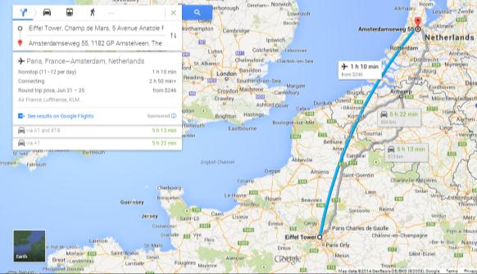
GOOGLE OFFERS ONE OF THE MOST ADVANCED SMART TRAVEL ASSISTANT PRODUCTSUITES (GOOGLE MAPS+NOW)
Example level 5
MAPS: Multi-modal travel planning including flights
NOW: Personalisation, relevancy: Artificial intelligence service that brings up information on a smartphone without a user even having to enter a query; considers contextual cues like physical location or the time of day to pull up relevant content like maps or restaurant listings
Cross-selling of other Google owned services throughout the journey
Similar: Yahoo acquired Aviate, Twitter bought Cover, Apple with Spotlight (powered by Microsoft)
Notes:
Google offers one of the most advanced product suites in terms of IPITA’s overall objectives, having introduced new features incrementally over time. Google Transit, a public-transport planner, is integrated with Google Maps, covering many major cities and providing real-time updates on traffic and disturbances. Google Glass, the wearable head- mounted display, supplies travel information using Google Transit and Google Maps and is voice-activated, making the system into an intelligent personal assistant providing customized travel information. The current product suite does not offer ticketing or mobile payment options.

Slide 14
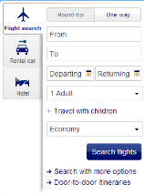
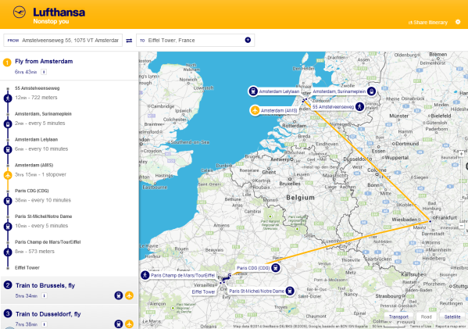
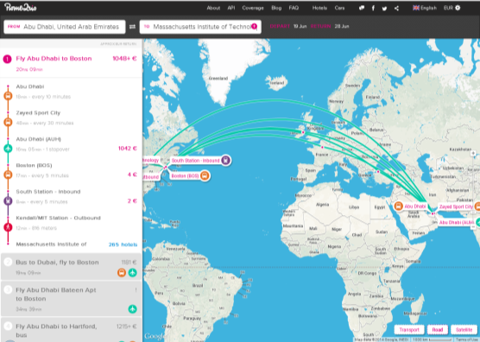
LUFTHANSA STARTED EXPERIMENTING (ROME2RIO) WITH LEVEL 5, BUT STILL FAR FROM FULL POTENTIAL
Example level 5
Multi-modal travel search including fares
Neutral own label, as well as (biased) white-label
Integration of hotels, cars and ridesharing

Slide 15
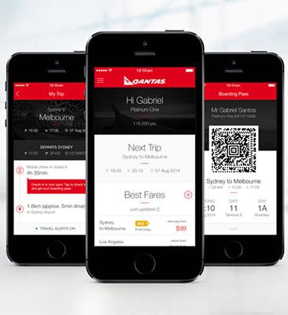
…QANTAS ALSO IN EARLY STAGE DEVELOPMENT
Example level 5
Personalized end-to-end travel app, designed to simplify the end-to-end travel experience for passengers
Real-time information to passengers and recommendations depending on which stage of the journey the passenger is at, e.g.
best method of check-in – mobile, online or airport,
what time to leave for the airport based on current location
best route to the airport based on real-time data from Google Maps
Notes:
Qantas has upgraded its iPhone app* with a smarter and more personalised interface to help streamline the day of travel experience for customers.
The new version delivers real-time information and alerts customers to the steps they need to take to check-in, get to the airport, navigate the terminal, board the aircraft and collect their bags. Optimised for iOS7, the app has also retained its original features including the ability to buy airfares, book a hotel, view Frequent Flyer points and create sale and special offer fare alerts to preferred destinations.
Qantas Domestic Chief Executive Officer Lyell Strambi said the app’s improvements are a response to customer feedback and the drive to provide a smarter, more tailored experience.
“Our customers wanted to be able to see at a glance when they need to check in, leave for the airport or head to the gate. They wanted an even simpler way to check-in, and greater access to up-to-the-minute departure information. The latest version of the Qantas Airways app delivers on this,” said Mr Strambi.
“It creates a personalised travel timeline to make airport departures and arrivals a breeze.”
“As a full service travel companion, the app anticipates all your travel needs - putting timely and relevant information in your hand when you need it. This lets our customers focus on the meeting they are flying to or the holiday reading they bought for their trip.
“The app also lets us keep our more regular flyers informed and up-to-date while they’re on the move. User recognition lets Qantas Frequent Flyers monitor their points balance, view upcoming flights at a glance and make bookings easily.”
“Over half a million customers are already enjoying the benefits of our app, with these new considered enhancements we expect even more customers to embrace the app.” Key features: • Recommends the best method of check-in (mobile, online or airport) (NEW) • Provides flight and boarding time alerts (NEW) • Lets customers know what time they will need to leave for the airport using their current location (NEW) • Locates the best route to get to the airport pulling data from Google Maps (NEW) • Reminds customers which lounges they have access to and where they are in the airport terminal (NEW) • Delivers up to the minute flight status information (NEW) • Shows the customer which gate they are boarding from (NEW) • Notifies the customer which baggage carousel their luggage can be retrieved from (NEW) • Gives the customer access to travel deals and discounts via personalised sale alerts (with the option to be alerted by price preference and/or destination) • Enables customers to search and book flights and hotels • Makes it easy to share deals and discounts with friends and family • Shows Frequent Flyers their points balance and next flight information at a glance The Qantas Airways app for iPhone is available now for free in the iTunes App Store. An Android Version will be released later in this year. Other Qantas apps on the market include the Qantas Frequent Flyer app that helps Frequent Flyers locate Qantas Frequent Flyer partners on the go and Qantas’ inflight magazine Qantas The Australian Way, is also available for iPads.

Slide 16


RETAILING MATURITY LEVELS LEVEL 6: TRIP INITIATOR
Selling process
Customer benefits
Capabilities needed
Based on our journey management capabilities and deep knowledge of our customers, offer pro-actively personalized reasons to travel and offer a complete packaged travel experience
Unique experiences
One-click booking of complete trip
AFKL benefits
Higher conversion and loyalty
Stimulation of travel
Access to unique events/experiences around the world
Dynamically matching customer needs with the events
Generating travel solutions for the personalized packaged travel
Assortment
Competitors
Examples
As in level 5, but also knowledge of local events
Experience providers: such as Vayable, packaged tour organizers, concert/event organizers
Travel marketplaces like Airbnb
Search providers offering pro-active personalized suggestions such as Google Now, Apple Passbook
OTA’s such as Expedia
Notes:
“Deploying Big data with analytics, a few global innovation led legacy airlines could redesign their businesses and transition from being providers of air transportation services from airport to airport to selling travel experiences, or becoming total travel facilitators by connecting the dots and by working with new third party players. And, it is through the integration of data (connecting the dots) that will generate new value.” NT Designing Future Oriented Airline Business

Slide 17
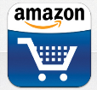

RETAILING MATURITY LEVELS LEVEL 7: AIR FRANCE KLM AS GENERAL RETAILER
Selling process
Customer benefits
Capabilities needed
Leverage a combination of retailing models (e.g. market-place, specialist reselling, brand direct-to-consumer) to offer customers a convenient and personalized way to buy anything they want
Waiting time becomes shopping time
Convenience: one stop-shop
Low prices through global presence and large volumes
AFKL benefits
Larger customer share of wallet
Increased revenues
Less dependency on volatile airline products
Assortment that fits the total lifestyle of selected customer group
Assortment
Competitors
Examples
Growing assortment from products related to travel to anything our customers might like to buy
On- and offline generic resellers, specialist resellers and marketplaces targeting the same customers; e.g.
Amazon
Ebay
Notes:
This level is provided just as a

Slide 18
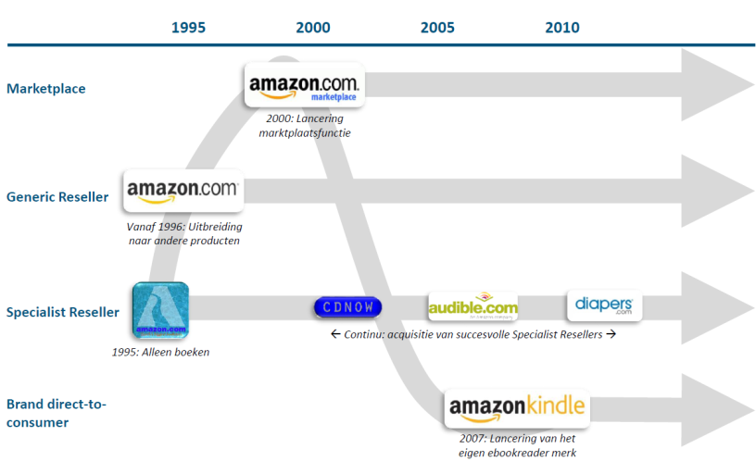
SUCCESSFUL GENERAL RETAILERS COMBINE MULTIPLE RETAILING BUSINESS MODELS example level 7
2000: Launch of marketplace function
From 1996: Expansion to other products
←On going: acquisition of successful Specialist Resellers→
1995: Just books
2007: Launch of own ebook-reader brand
Notes:
Mission: since 1995! “To be Earth’s most customer-centric company, where customers can find and discover anything they might want to buy online, and endeavors to offer its customers the lowest possible prices.”
The mission is stable. The business model is flexible.

Slide 19



RETAILING MATURITY LEVELS WHAT COULD BE NEXT IN RETAILING FOR AIR FRANCE-KLM
New business models
level 1
+ level 2
+ level 3
+ level 4
+ level 5
+ level 6
Smart travel Assistant
Trip initiator
Core product:
trip
Core product:
trip
Personalized offers
+ level 7
Travel related retailing
A la carte
All-in tickets
General retailer
Core product:
seat
Core product:
seat
Core product: seat
Core product: personalized offer
Core product:
general retailing
Mass product
(product centric)
Personal solutions (customer centric)
Notes:
AFKL have embraced the merchandising concept, as demonstrated
through product unbundling and the marketing of ancillary products and
services, in turn benefiting passengers and airlines alike. AFKL have also
made significant progress in the areas of product enhancement and pricing
in terms of “seat managing the values”.
However, they are still struggling in the area of “romancing” the customer, where an airline becomes the customer’s preferred choice, rather than the customer feeling forced to choose that airline.

Slide 20
RECOMMENDATIONS & NEXT STEPS
Air France - KLM is on the right track with retailing and should continue to develop level 2 and 3
Level 4 is still a challenge, but we should be able to manage that in combination with the development of Big Data capabilities in the company. Speed of implementation is crucial in this case
With regards to level 5-7: we need to first decide if this is the direction we want to take retailing in AF-KL and then further detail the ambitions and roadmap
If we choose to develop level 5-7, we believe that we need to partner and to insource specific retailing expertise needed for those levels
Especially level 7 seems to require a more unorthodox approach, like creating a general retailer startup under the umbrella of AF-KL
Passenger Strategy and Commercial domains remain in the lead

